Slide 1
Airlines Reservation System

Slide 2
01
02
03
04
Introduction
With problem statement, block diagram
Program
sneaks
Advantages
With Limitations
References

Slide 3
01
INTRODUCTION
Overview
Purpose

Slide 4
Introduction
The project aims to design an Airline Reservation System application which enables the customers to search and book flight . Airline Reservations Systems contain fare tariffs, passenger reservations and ticket records.

Slide 5
Overview
The Airline Reservation System project is an implementation of a general Airline Ticketing website like Orbitz, which helps the customers to search the availability of flights, book and cancel the flight tickets. This project also covers adding, deleting or modifying the customer details and flights. In general, this website would be designed to perform like any other airline ticketing website available online.

Slide 6
Purpose
The purpose of this project is to implement or to design an airline reservation system to check the flight details , book and cancel flight tickets. It makes the process of booking and cancelling flight tickets simple and easy for the passengers

Slide 7
Problem definition
Normally a person wants to reserve his ticket and he has to contact at nearest Overseas Travels branch. The Airline Reservation System provides an interface to schedule flights and reservations for an airline through internet. Its responsibility is to keep track of system users, customers, Airbus information, flight information and cancellation.

Slide 8
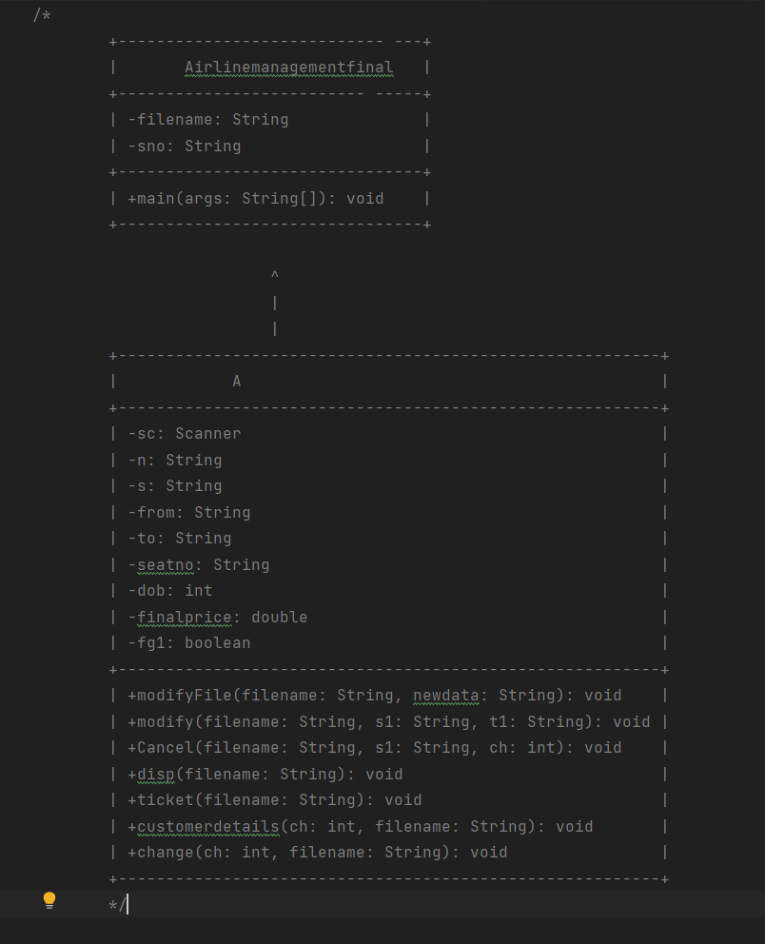
CLASS
DIAGRAM

Slide 9
METHODS IN THE CODE
modifyFile(String filename, String newdata):
Modifies the contents of a file by replacing it with the provided new data.
modify(String filename, String s1, String t1):
Modifies the contents of a file by replacing occurrences of a specific string with another string.
Cancel(String filename, String s1, int ch):
Cancels a ticket by removing the corresponding record from a file and updating the flight availability.
disp(String filename):
Displays the contents of a file.
ticket(String filename):
Processes the ticket booking by calculating the final price based on the booking and travel dates, and writes the ticket details to a file.
customerdetails(int ch, String filename):
Collects customer details such as name, age, destination, and seat number.
change(int ch, String filename):
Updates the flight availability by modifying the seat count in the corresponding file.
main(String[] args):
The main method that serves as the entry point of the program.

Slide 10
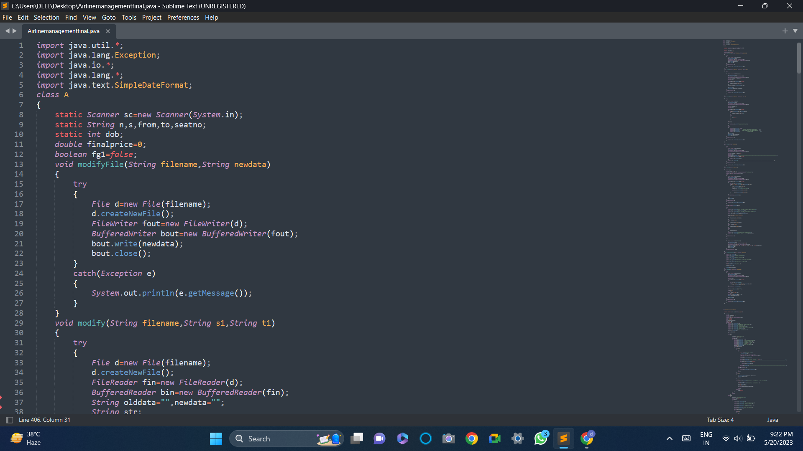

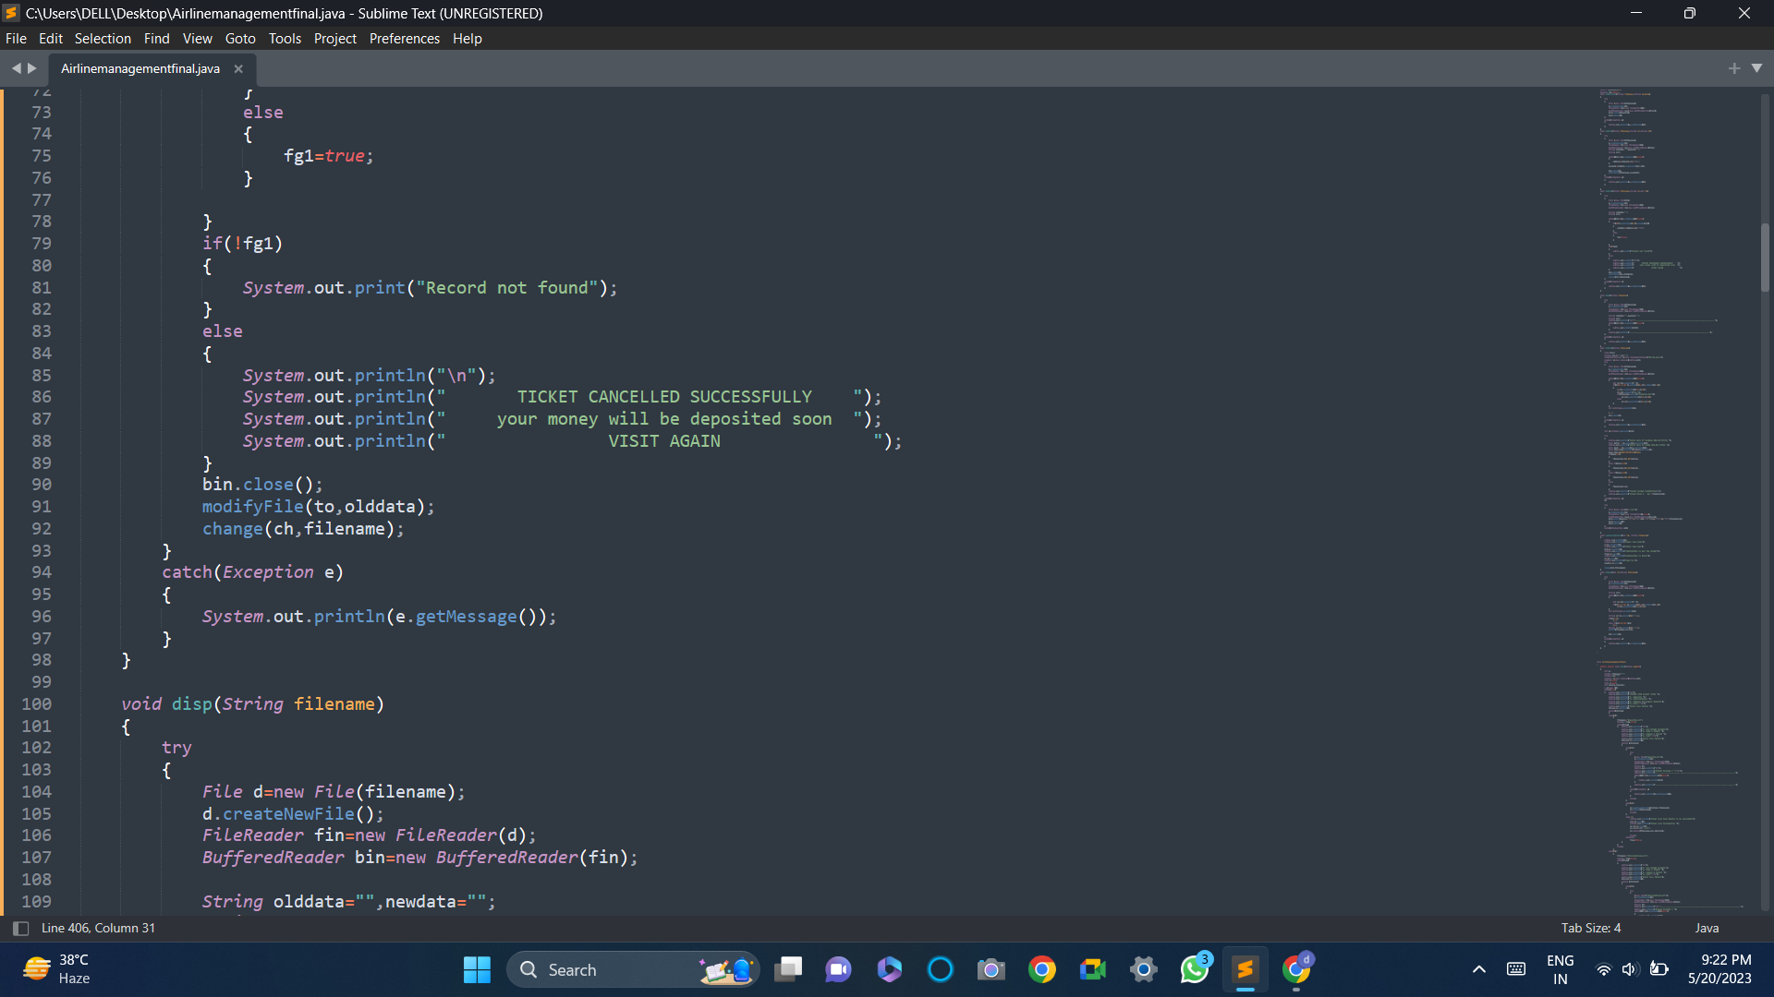
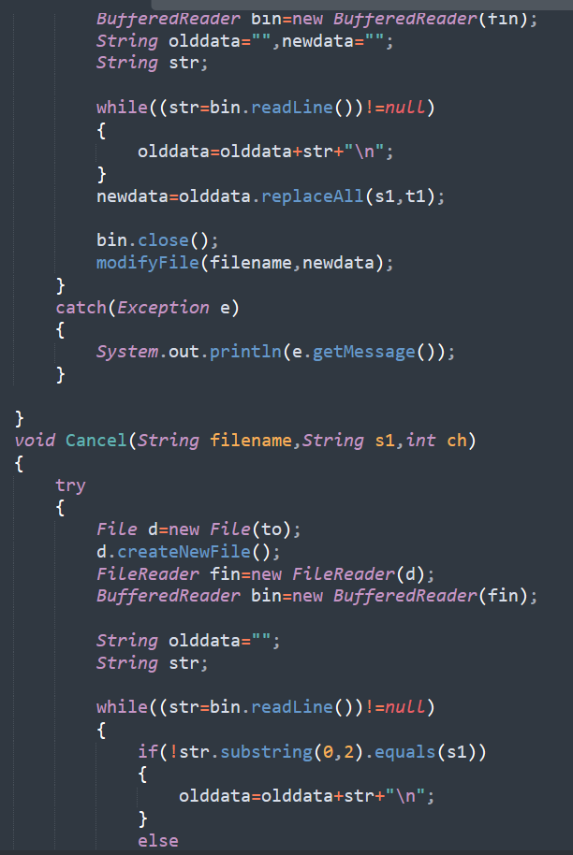

Slide 11
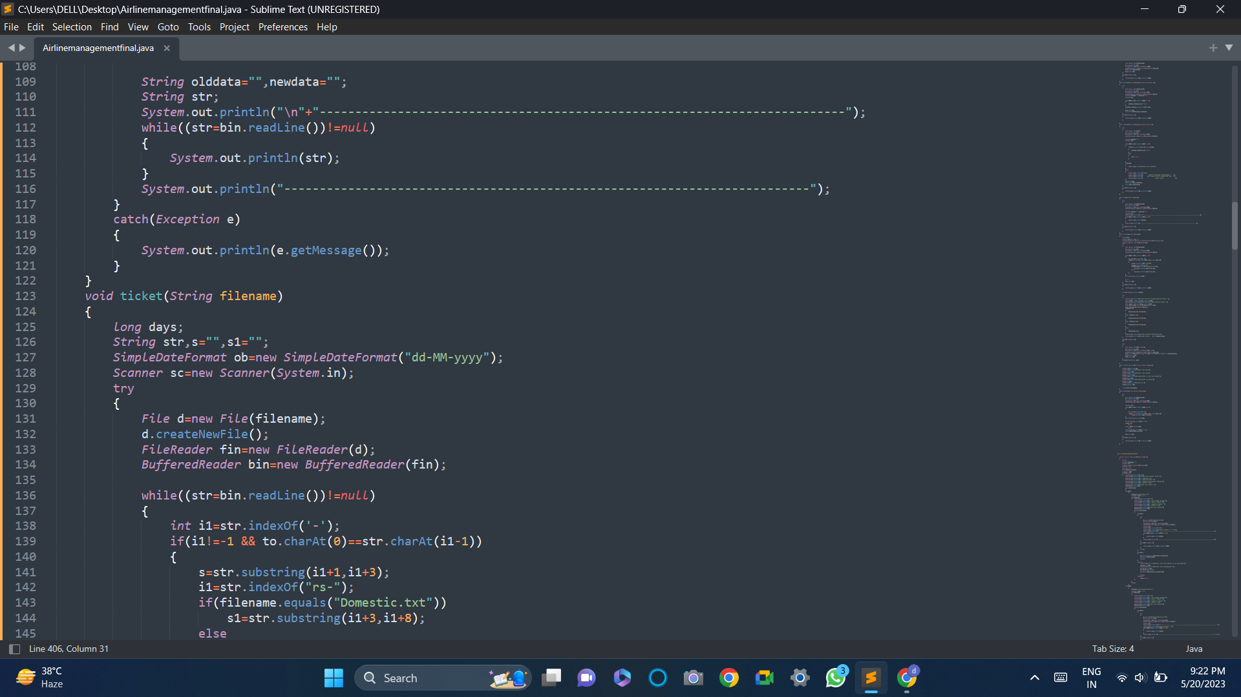
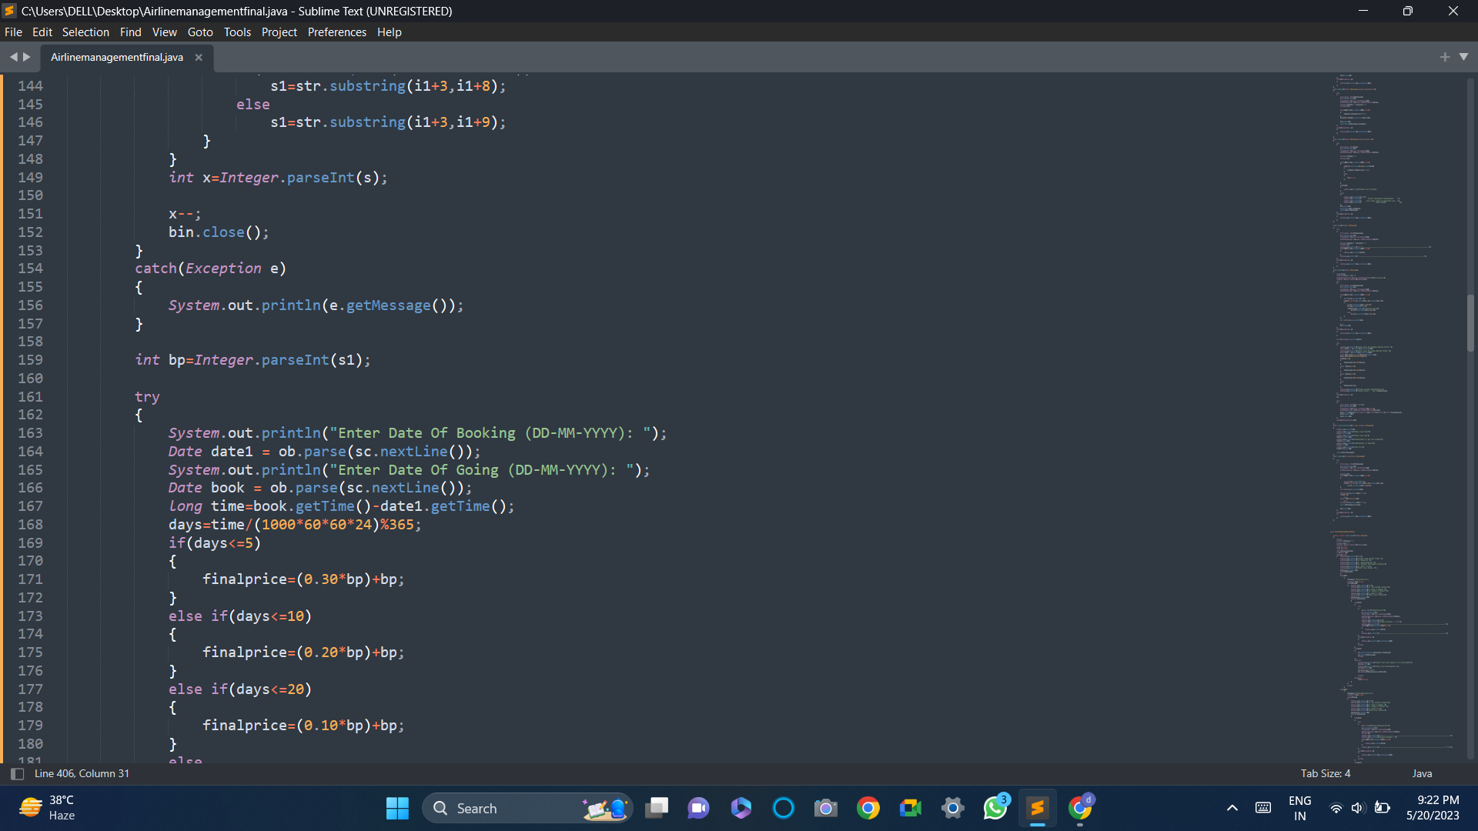
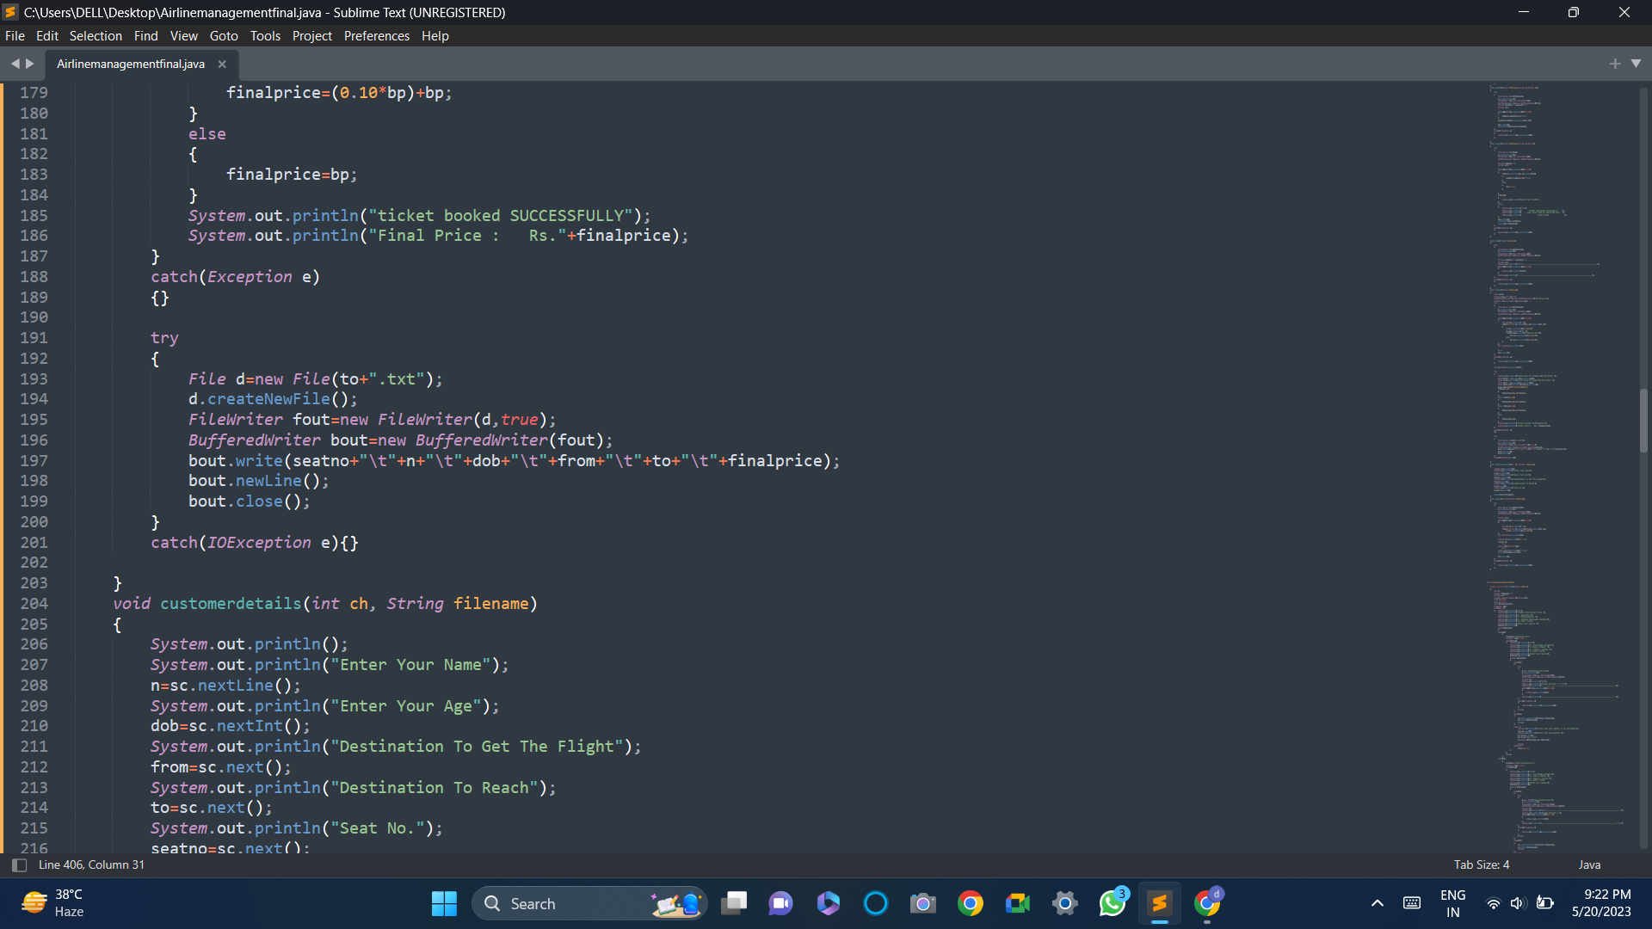

Slide 12
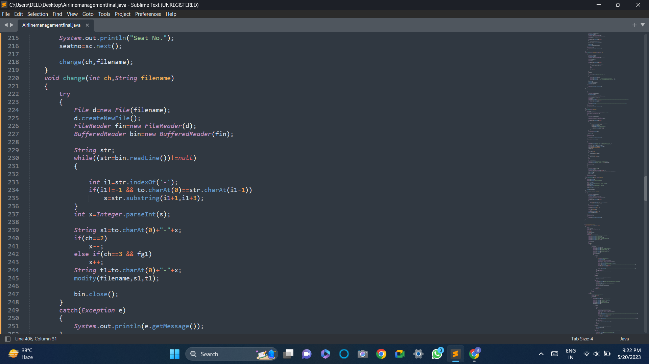
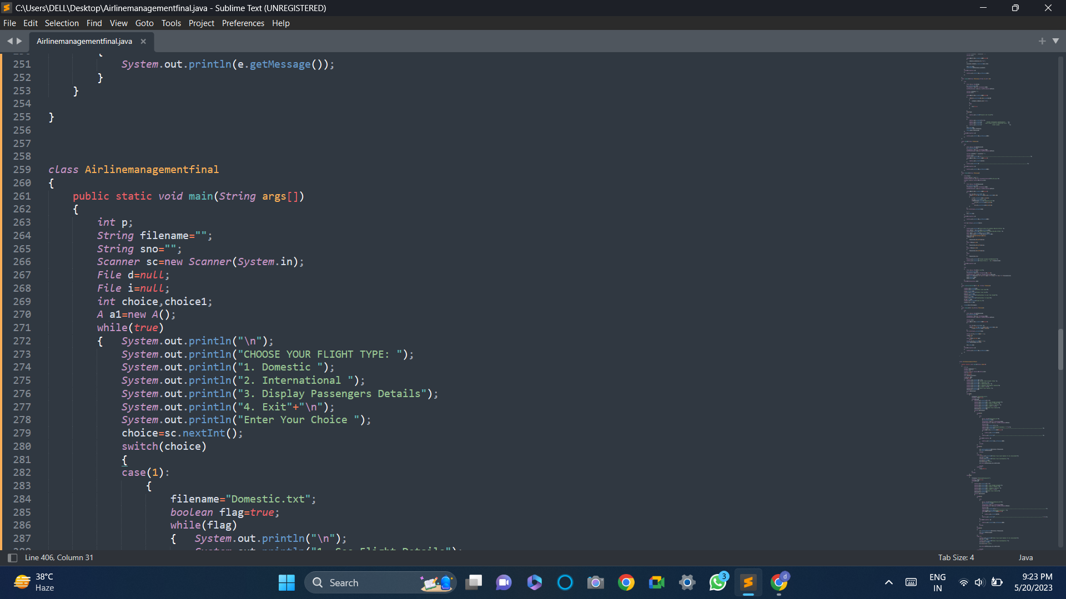
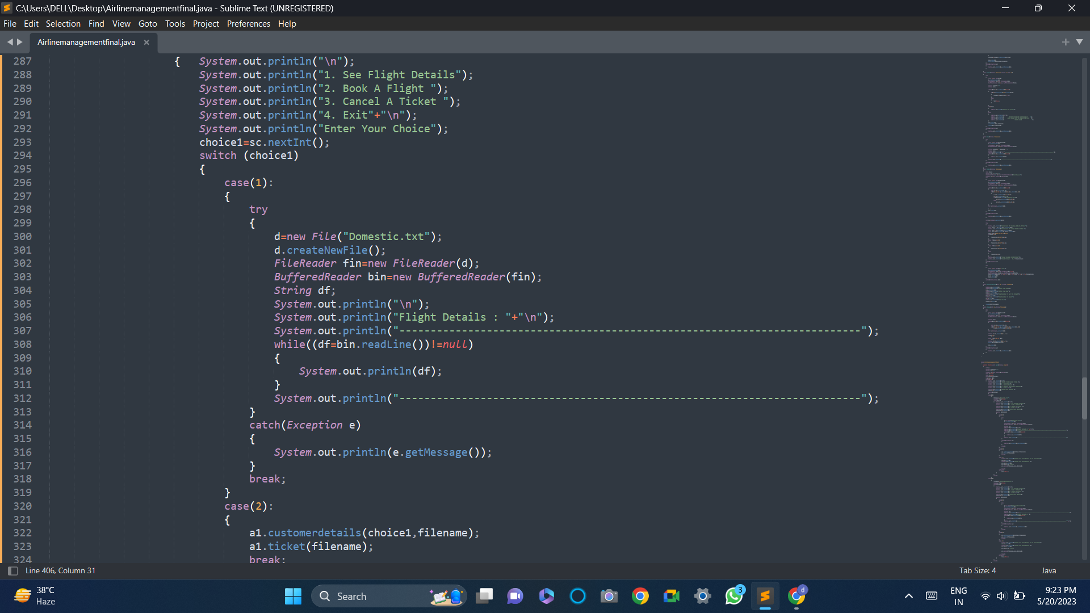

Slide 13
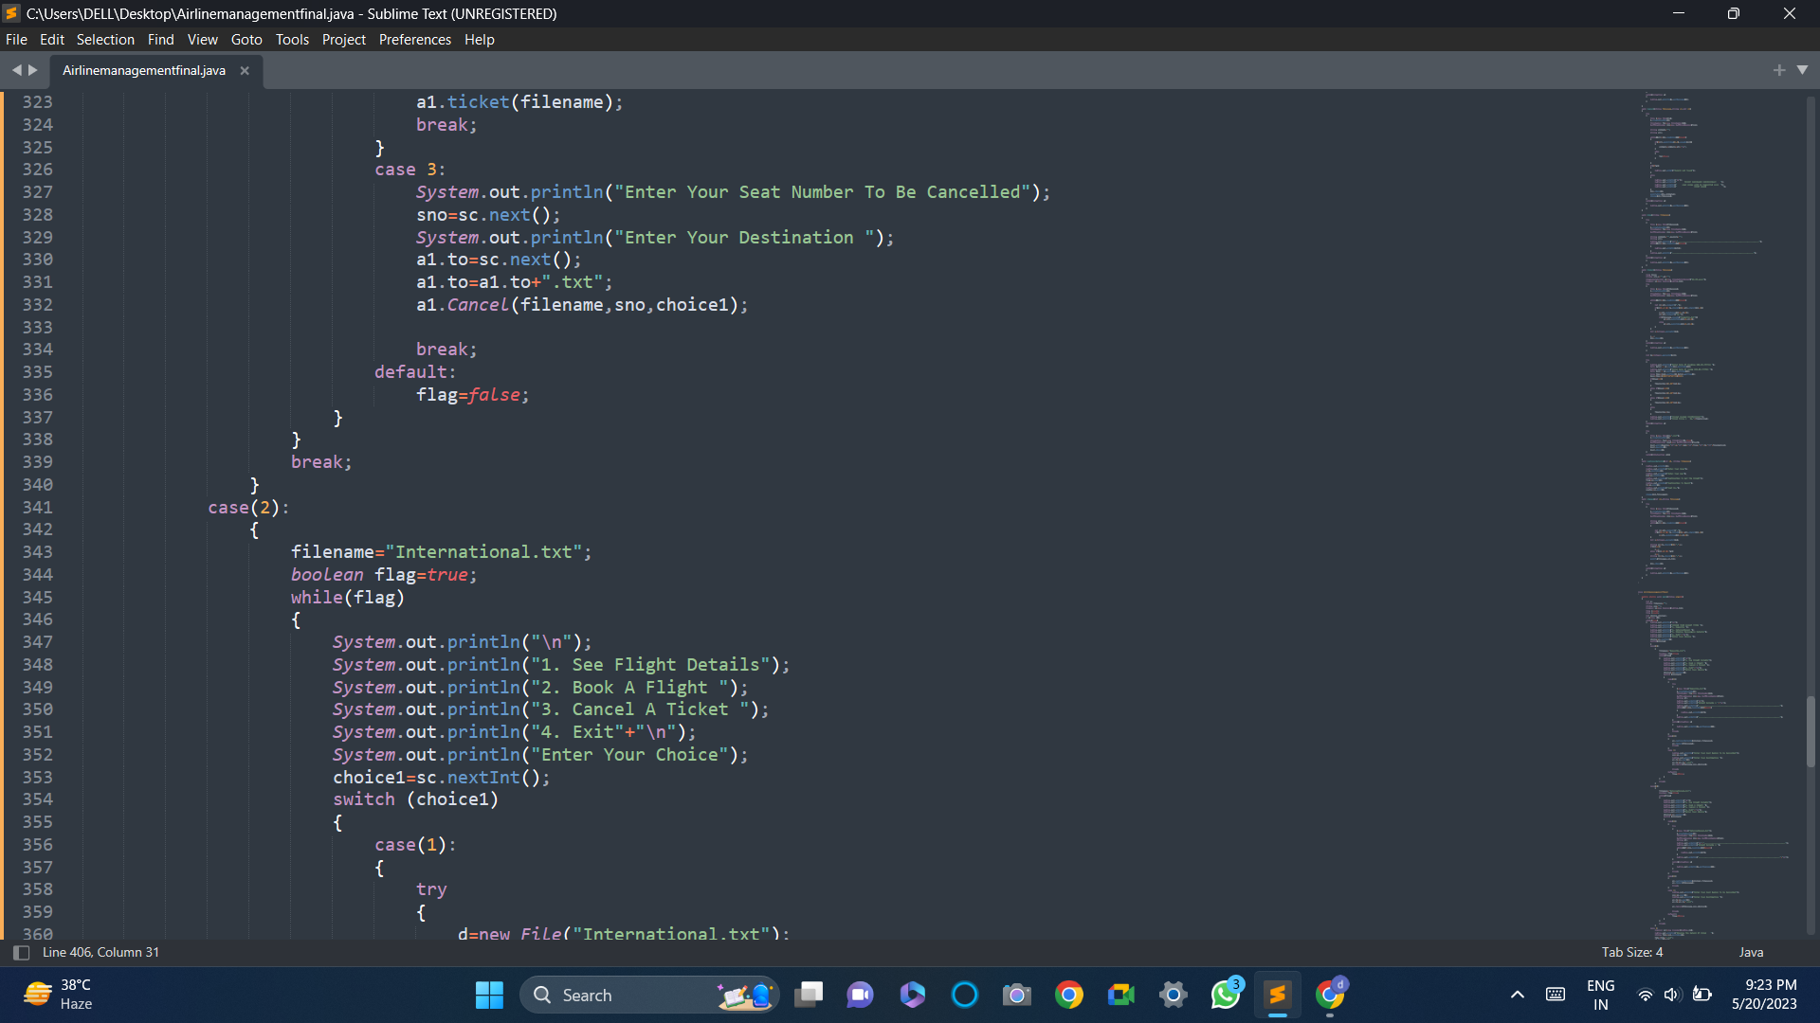
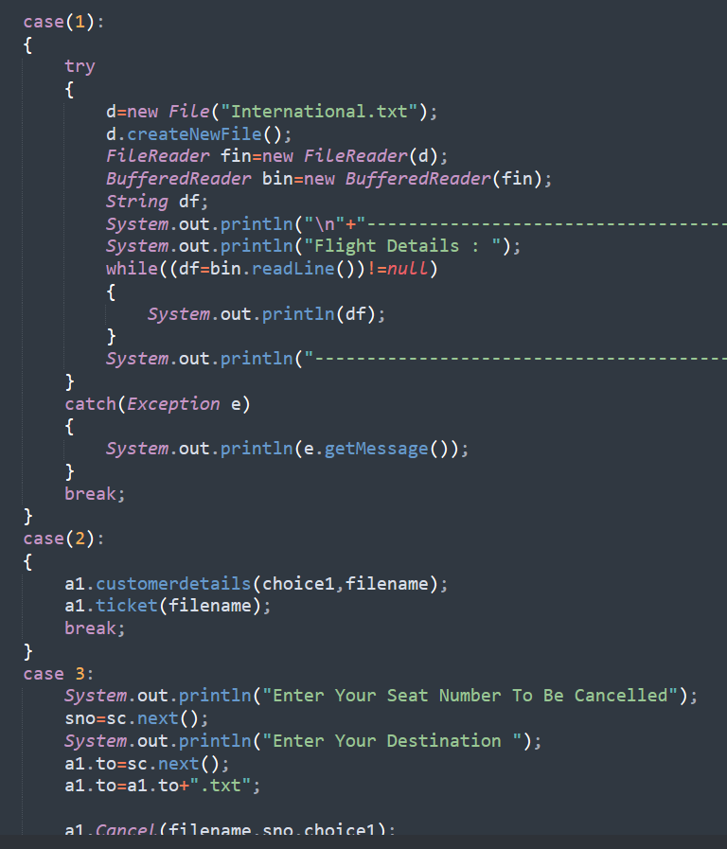

Slide 14
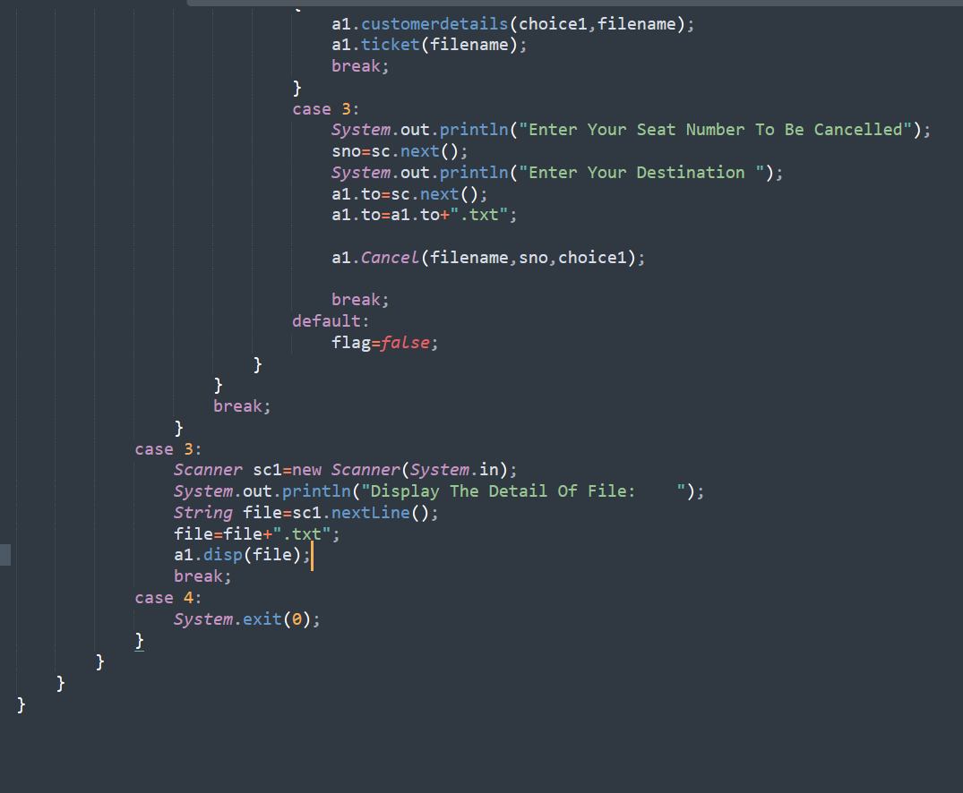

Slide 15
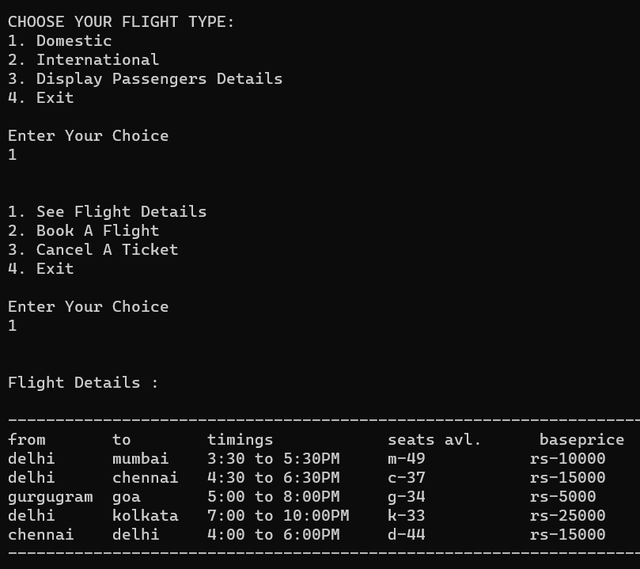
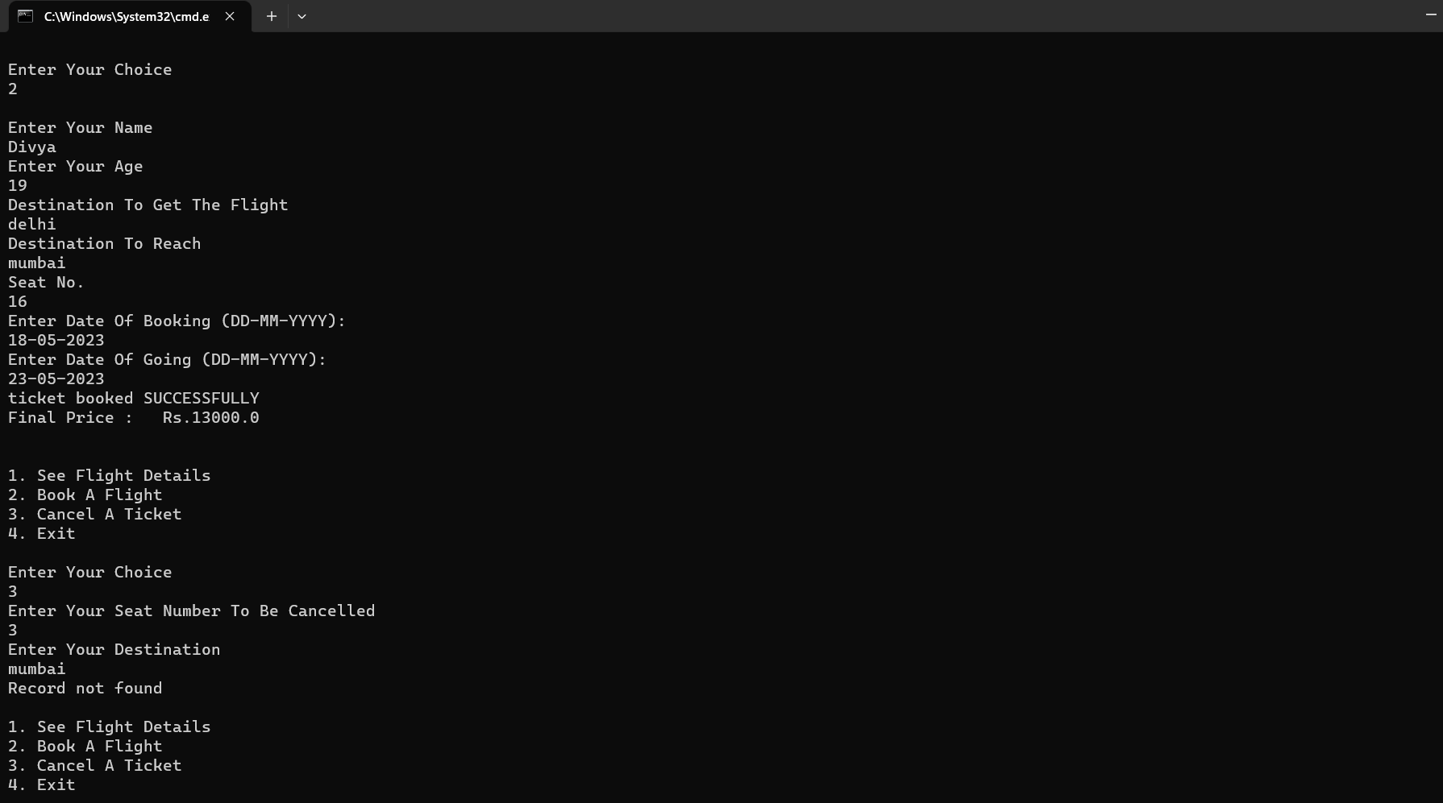
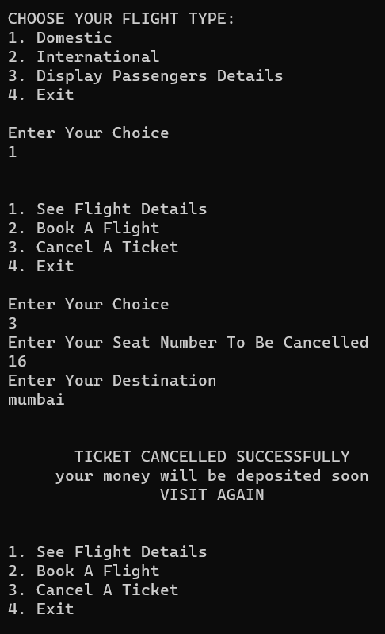

Slide 16
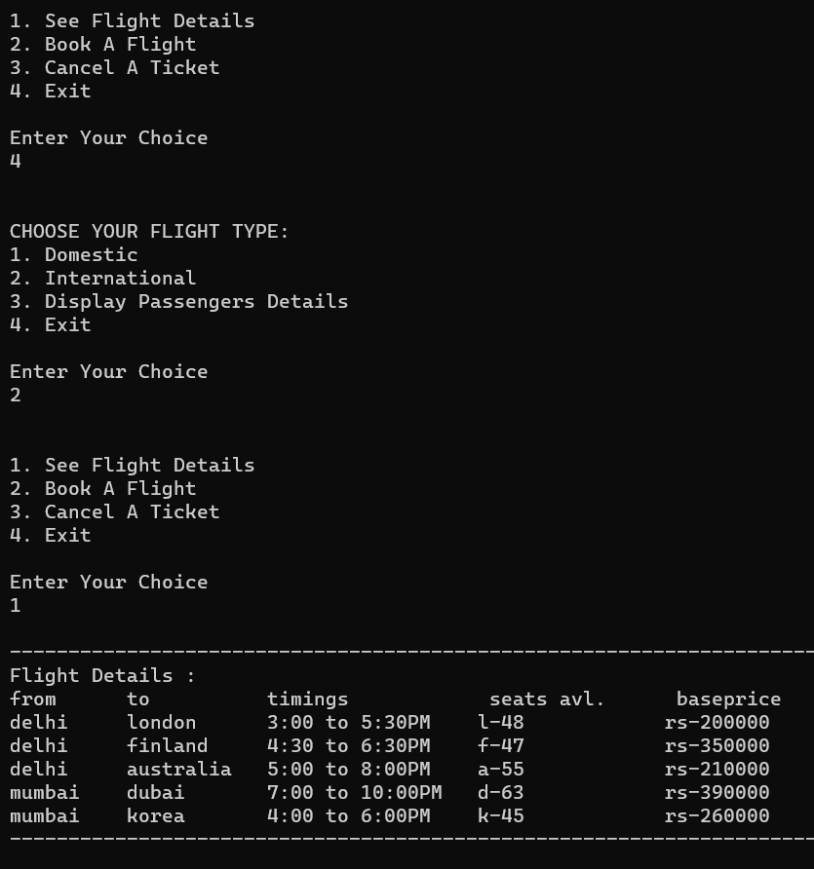
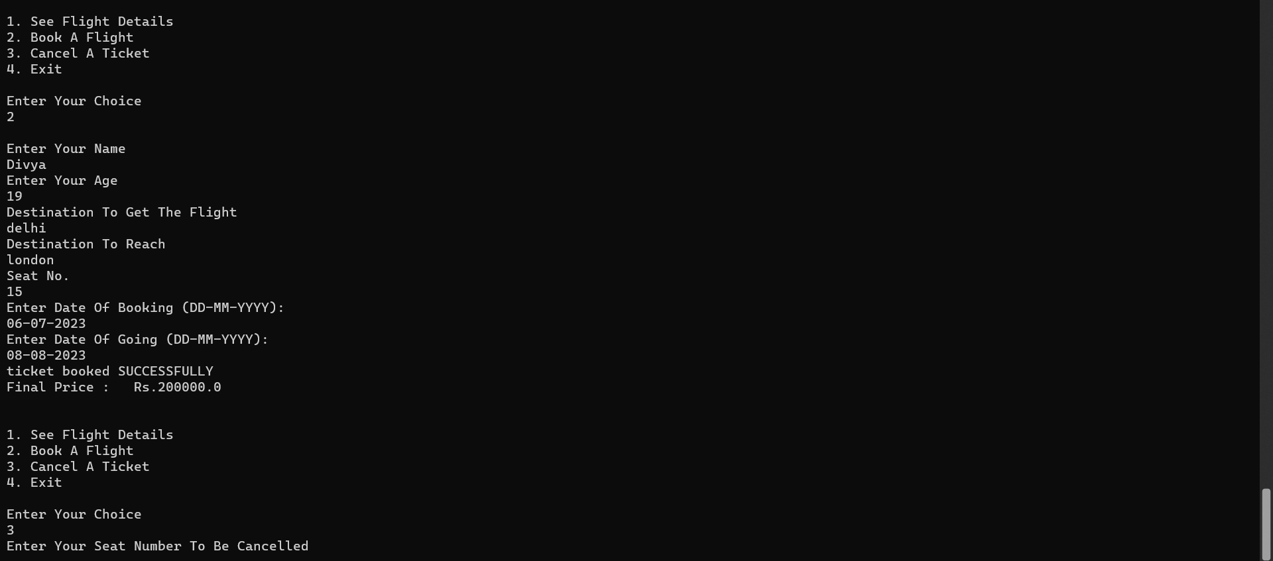
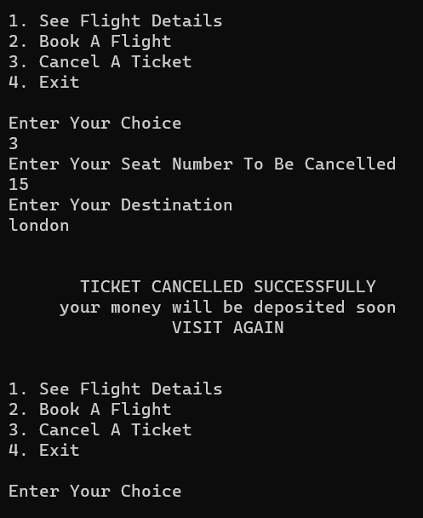

Slide 17
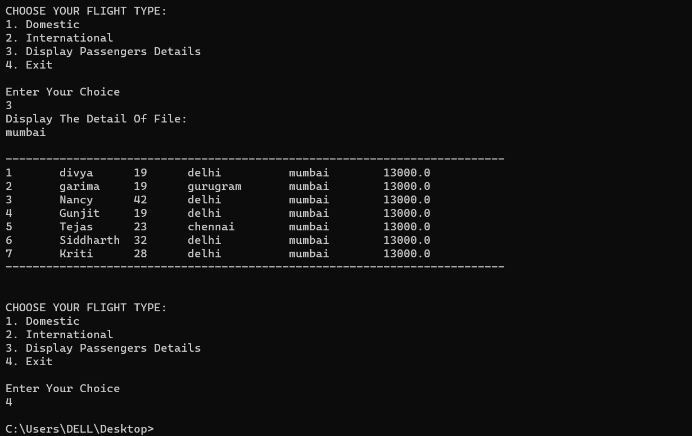

Slide 18
DRAWBACKS OF EXISTING SYSTEM
Entering Record : Entry of each record is done manually each time the record is done manual each time the record is maintained on paper and it maximizes the maintenance of additional files.
Searching the record :Due to absence of unique identification of a flight, the searching of record takes much time and increases the time wastage.
Deleting the Record :In the current system the concept of deleting record is tedious.
Modification of Records :If any modification is required it is done directly on the documents being preserved in correspondence to account information.

Slide 19
ADVANTAGES
The proposed system due to computerized is much faster in reservation process, cancellation process and transactions.
Transfer of information from various branches would become easier and faster.
Managing and maintaining data becomes easier and cost effective due to very high amount and reliability of storage space available in the proposed system. •
Customer services can not only be satisfied but also enhanced to the extent that one can obtain or cancel a reservation from any given time.

Slide 20
REFERENCES
www.W3school.com.
www.google.com.
www.youtube.com.

Slide 21
Thanks
Presented by:
Garima 22CSU067
Divya Chauhan 22CSU060
Garima 22CSU068
Gunjit Arora 22CSU074
Please keep this slide for attribution

